Slide 1
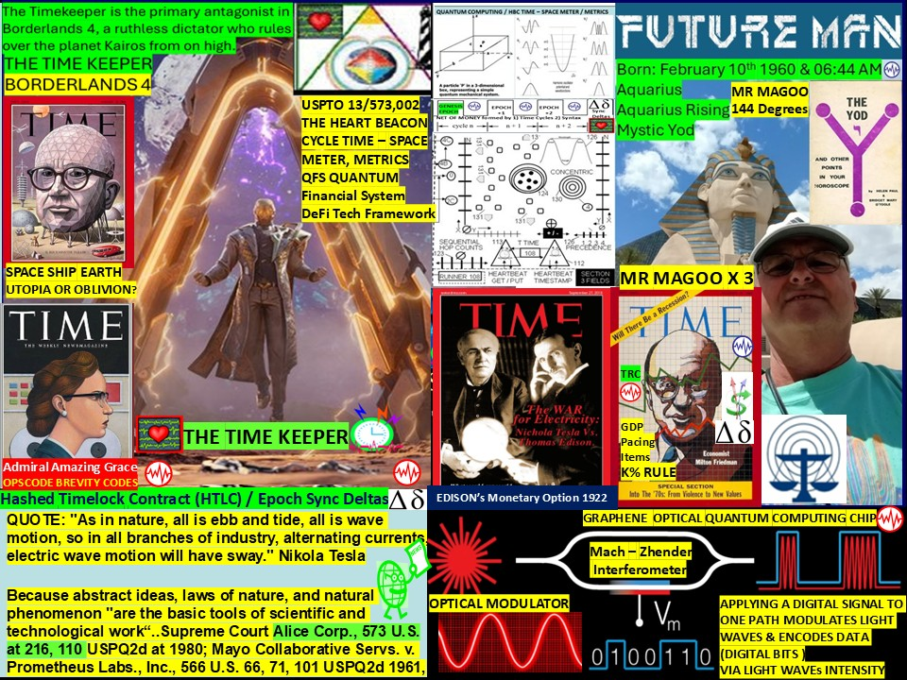

Slide 2
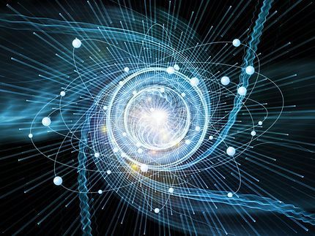
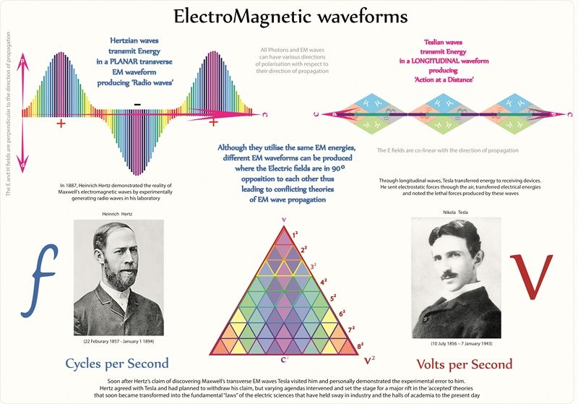

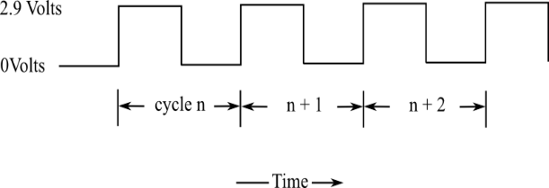
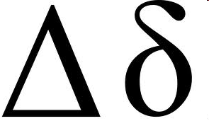
CLOSER = < Infrastructure
= CHEAPER SLA
SCALAR, LONGITUDINAL, STANDING WAVE”
“EVERYWHERE IS ENERGY SPINNING””
"As in nature, all is ebb and tide, all is wave motion, so that in all branches of industry, alternating currents, electric wave motion will have sway." N. Tesla
INTERNET = 1. TIME EPOCH CYCLES 2. Syntax (not) Processed in cycle
SYNC
DELTAS
GENESIS
EPOCH
Net, Net of $$$ = Epoch Time Intervals wave forms

Slide 3
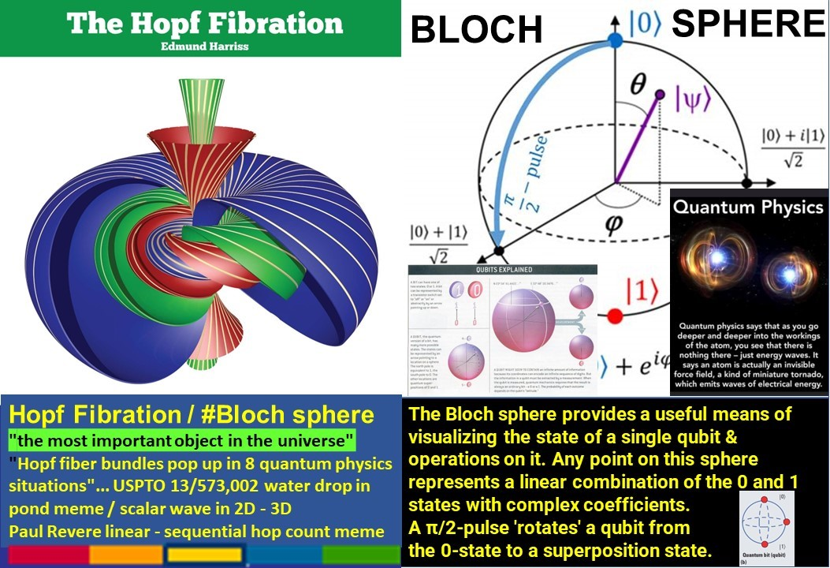
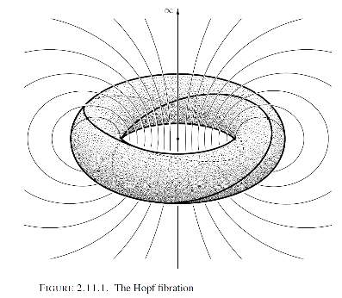
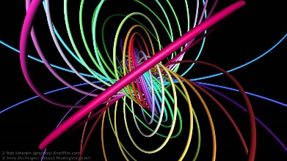
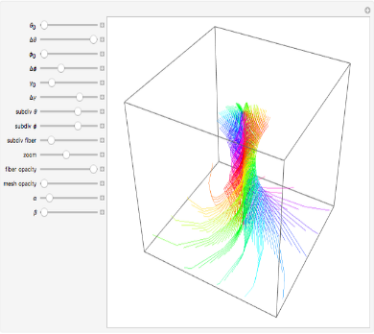

Slide 4
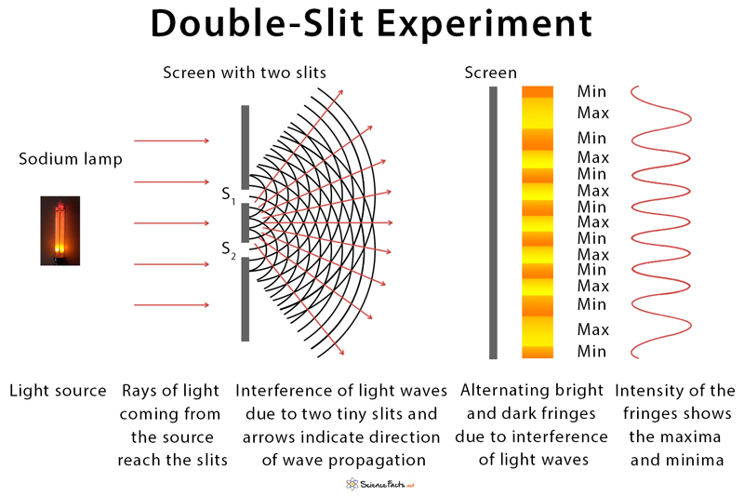
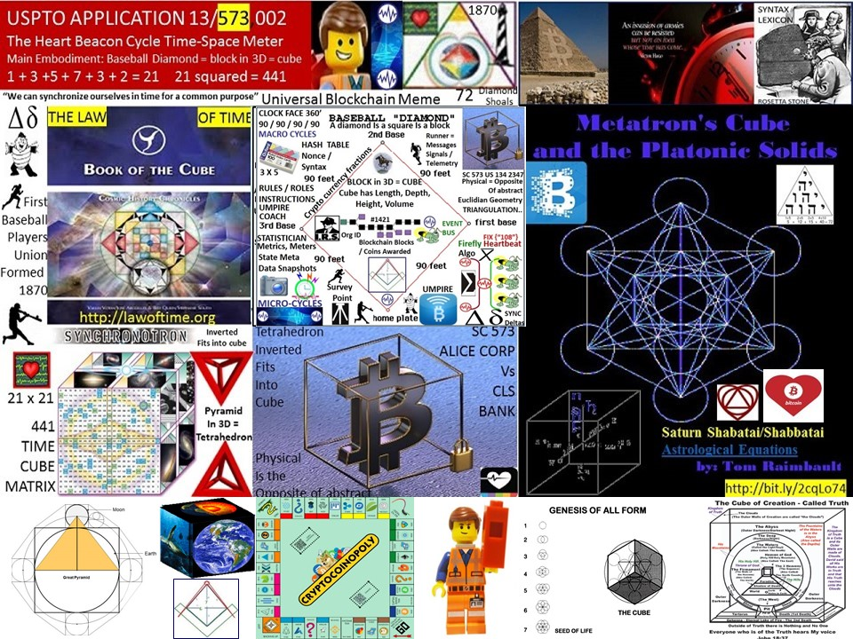
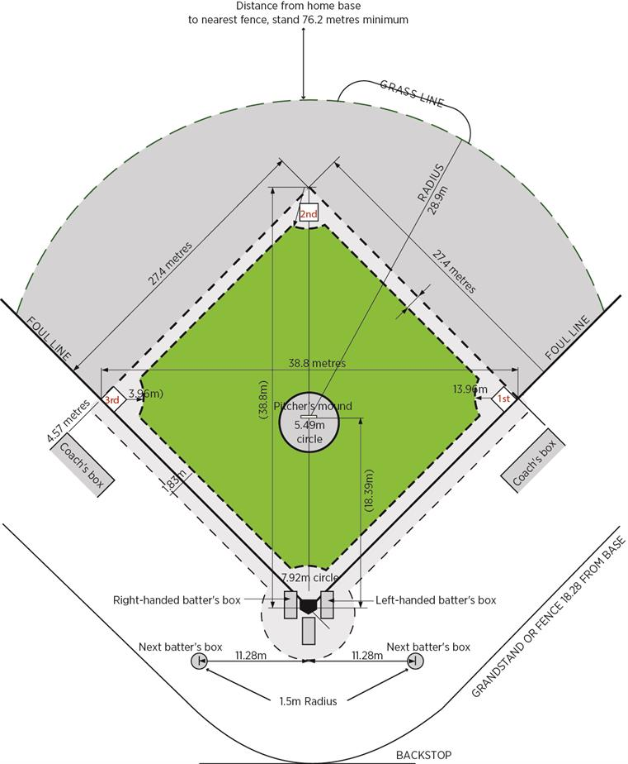
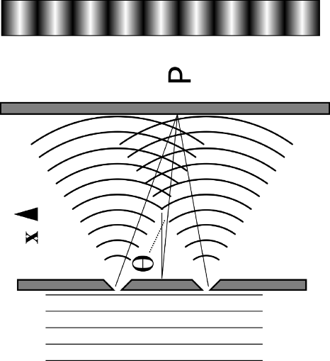
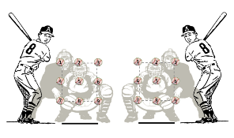
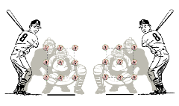
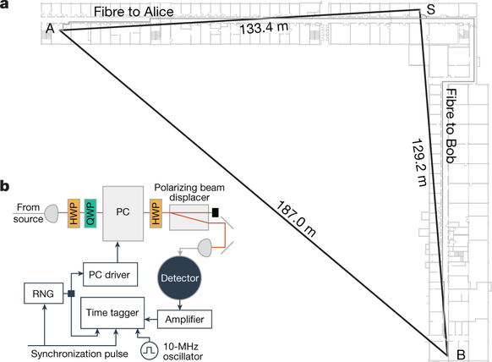
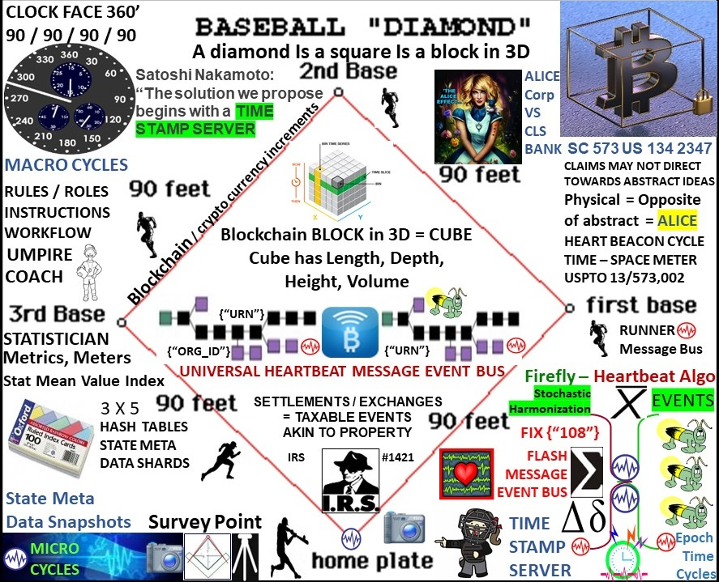
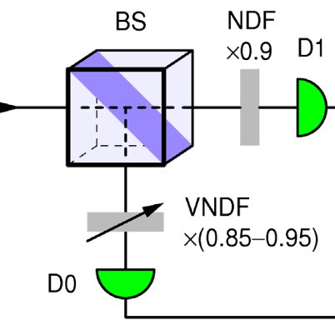

QUANTUM COMPUTING - RESISTANT ? - BASED ?
THROUGH LENS OF SCOTUS
ALICE LOOKING GLASS RULING
WAVE ?
PARTICLE ?
Batter’s Boxes
SCOTUS ALICE RULING: “Claims may not direct towards abstract ideas” / Physical = opposite of abstract
FREE SPACE TEMPORAL OPTICAL
NIST QUANTUM
RANDOM NUMBER
BEACON
METRICS / METERS
Stochastic
Harmonization
Notes:
Are your patent applications, granted patents written and described with SCOTUS Alice Corp Vs CLS Bank in mind? are your patent applications, patents grants descriptive to the quantum computing level - future proofed? Are they written to be quantum resistant or quantum based or both? What if events could be propagated by waves - is there a need for liquid nitrogen if the method and means is light wave laser based? Why go the liquid nitrogen route if we know the challenges in maintaining consistent temperatures across the globe at sea level Vs mountain tops, equator Vs poles... and don't forget the need to stochastically harmonize data sampling fluctuations across the world's time zones...

Slide 5
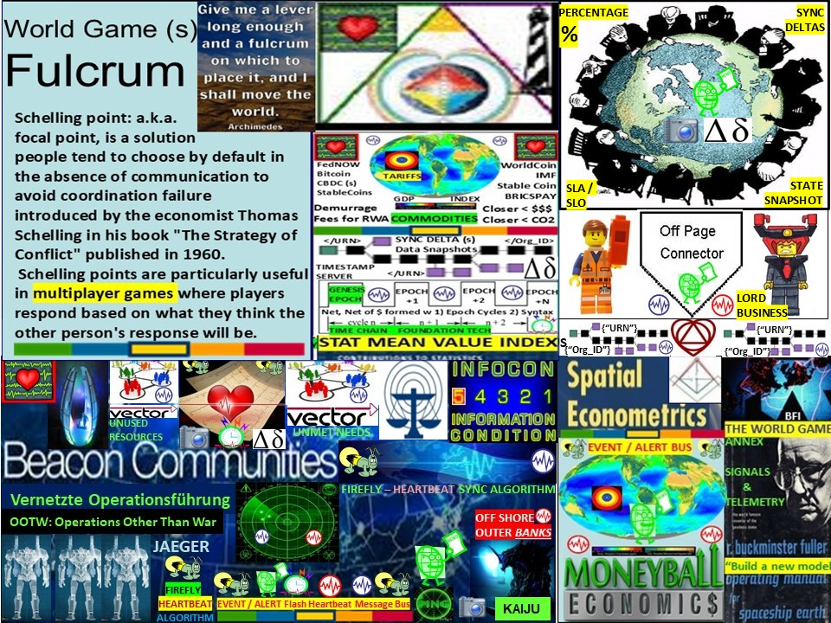

Slide 6


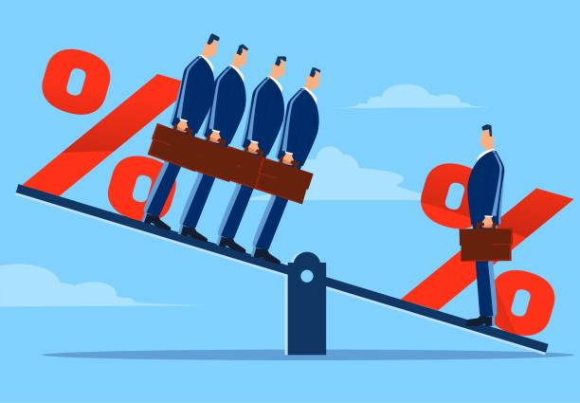
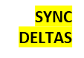
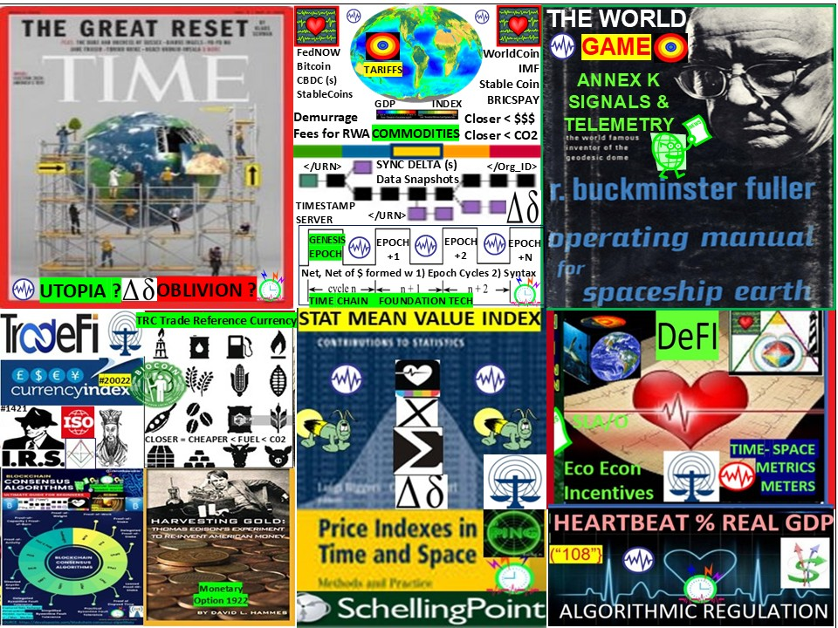
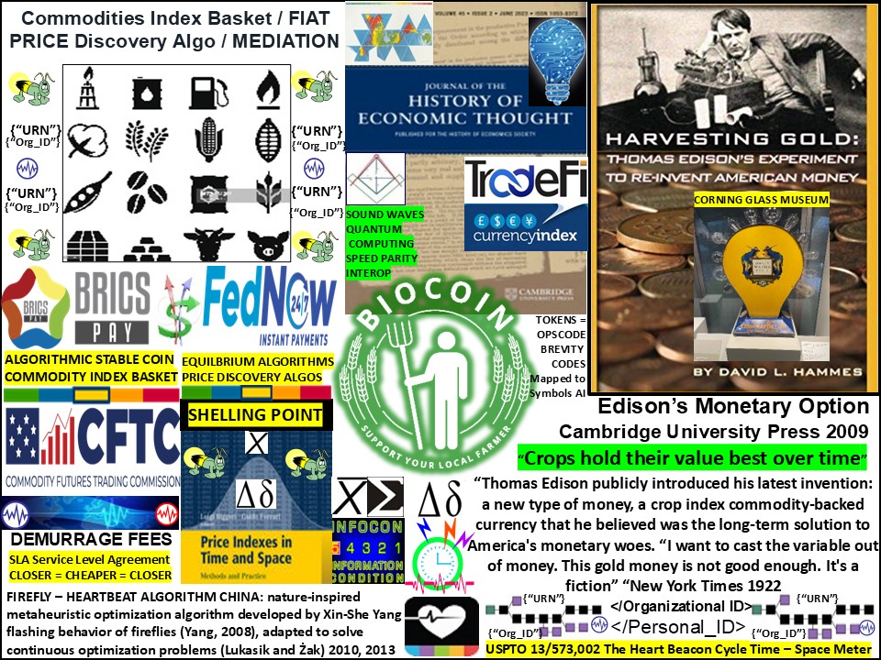

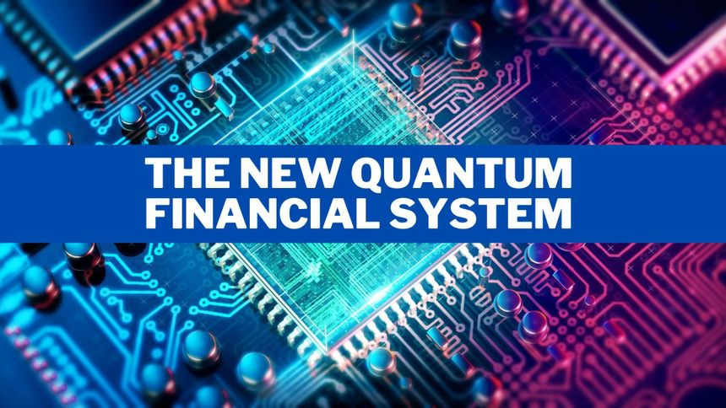
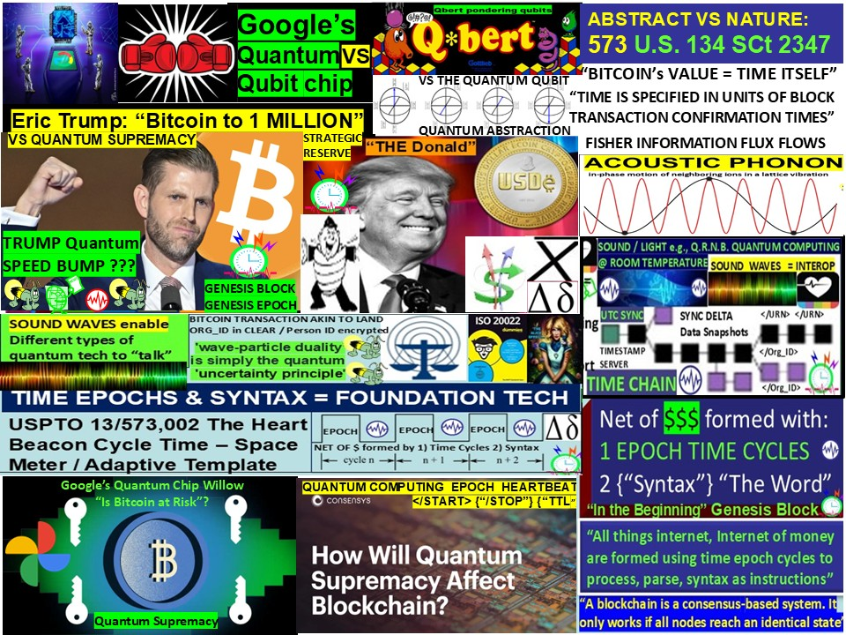
World Game (s) Fulcrum
Schelling point: focal point = solution choosen by default in the absence of communication to avoid coordination failure introduced by the economist Thomas Schelling in his book "The Strategy of Conflict" published in1960.
Schelling points are particularly useful in multiplayer games where players respond based on what they think the other person's response will be.
STATE SNAPSHOTs
Schelling Point Conference: focuses on the intersection of cryptocurrency and social good, bringing together innovators, thought leaders, and advocates to explore how blockchain tech can create positive change. Schelling points are not always definite solutions and their conspicuousness can depend on time, place, and individuals

Slide 7


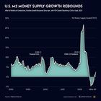
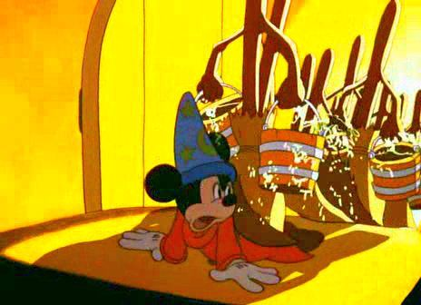

Fantasia Movie FIAT = “By Decree”
The film Fantasia involves Mickey Mouse, as the apprentice, uses a magic broom to carry buckets of water. Fantasia’s buckets re associated with the "Sorcerer's Apprentice" segment from the 1940 animated film
“NAKED SHORT SELLING”
DERIVATIVES
QUANTITATIVE EASING
a.k.a. “money printer go brrrrrr”

Slide 8
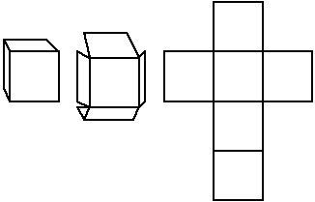
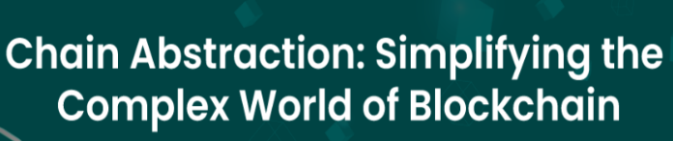
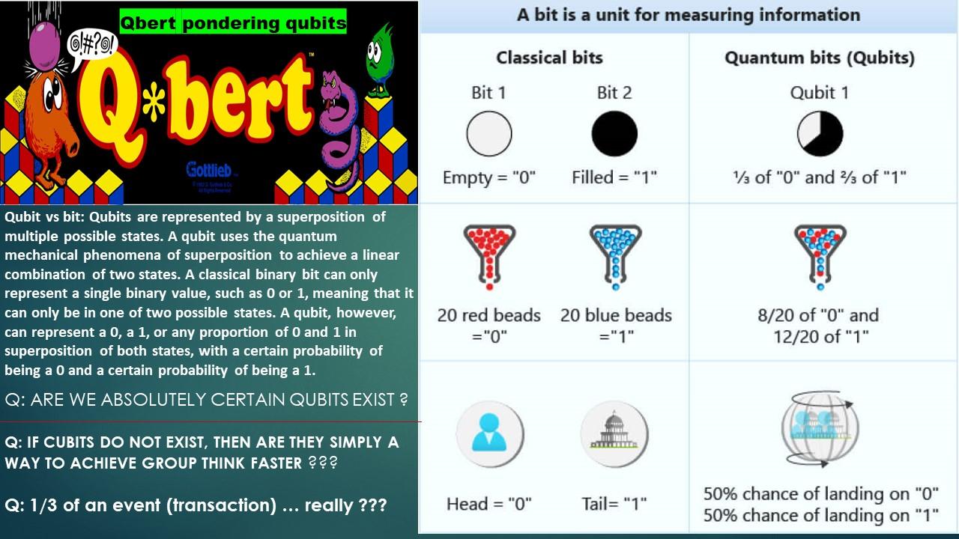
“BLOCKCHAIN”
CUBE = SOURCE OF ALL FORM
SCOTUS Alice in Wonderland Ruling 2014
ABSTRACTIONS MAY NOT BE CLAIMED:
The Net, Net of Money (Cryptocurrency)
Does not have / has no:
LAYERS i.e., seven layer internet model
BLOCKS on the BLOCKCHAIN
Blockchain data stored in a CUBE
- QUBIT (S) quantum two state system
- Packets i.e., Vinton Cerf’s “ode to a packet”
Lightchain AI introduces Proof of Intelligence
(PoI), consensus mechanism designed to
reward nodes for performing AI computations
i.e., model training, inference, optimization...
All computing is essentially workflow logic
If, then, else then do {‘task”} multicasted,
Unicasted, anycasted / filtered over TCP / IP
QUBITS STORED
ON A BLOCKCHAIN
Nikola Tesla “All is wave form motion”
INTERNET, NET OF $$$ TRUTH = WAVE FORMS

Slide 9
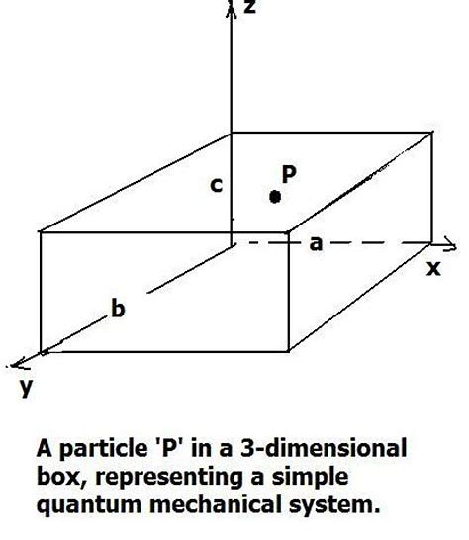
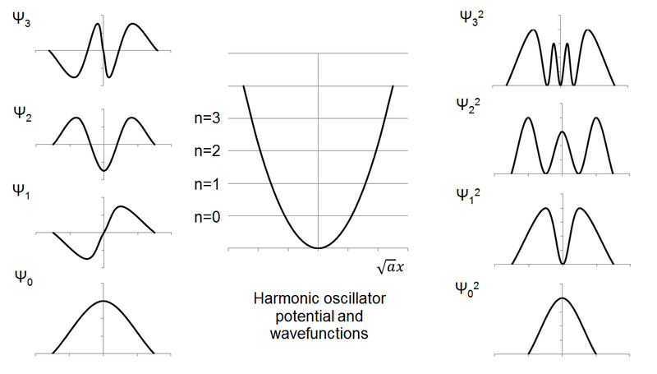
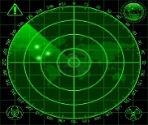



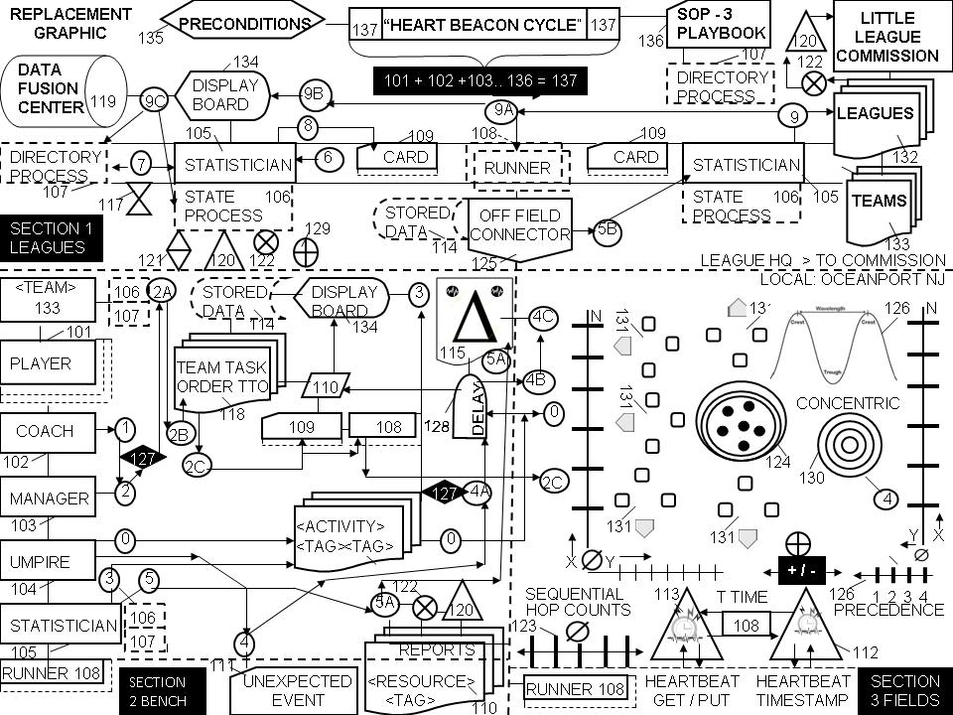
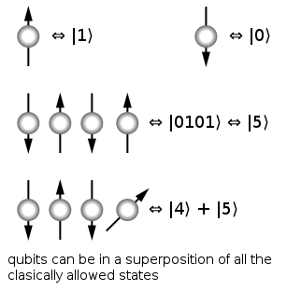
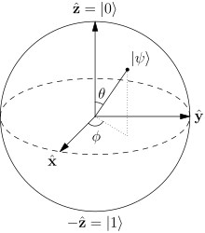


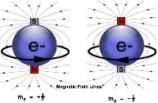
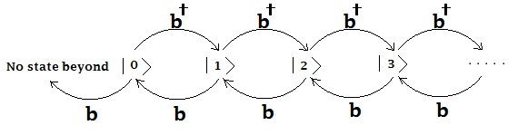
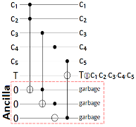
#QuantumComputing USct Alice Corp Vs CLS Bank compliant memes:
QUANTUM COMPUTING / HBC TIME – SPACE METER / METRICS
In quantum computing, a qubit (or quantum bit (sometimes qbit) is a unit of quantum information—the quantum analogue of the classical binary bit. A qubit is a two-state quantum-mechanical system, such as the polarization of a single photon: the two states are vertical polarization and horizontal polarization. In a classical system, a bit has be in one state or the other. Quantum mechanics allows a qubit to be in a superposition of both states at the same time, a fundamental quantum computing property
US Sct Alice Corp Vs CLS Bank Physical memes
Linear sequential “Paul Revere” meme = horizontal polarization
Vertical polarization vectors from a known point 0 null Sonar Hop meme
particle representation / samples
Instead of each bit having two potential states — on or off — a quantum bit or qubit has three. It can be on, off, or both, and you only know which one it is once you look at it. How can you tell if a bit of data is correct if looking at it might change its state?
STATE CHANGE EVENT
.
universal gate set
STATE CHANGE EVENT
qubits initialized
to arbitrary values
quantum gates
BLOCH SPHERE
Microwave pulses like sonar ping…
silicon device movement is controlled through use of microwave pulses. As an electron spins up, a binary value of 1 is generated, when the electron spins down, a binary value of 0 is generated.
Fock state number state quantum state that is an element of a
Fock space with a well-defined number of particles (or quanta).

Slide 10
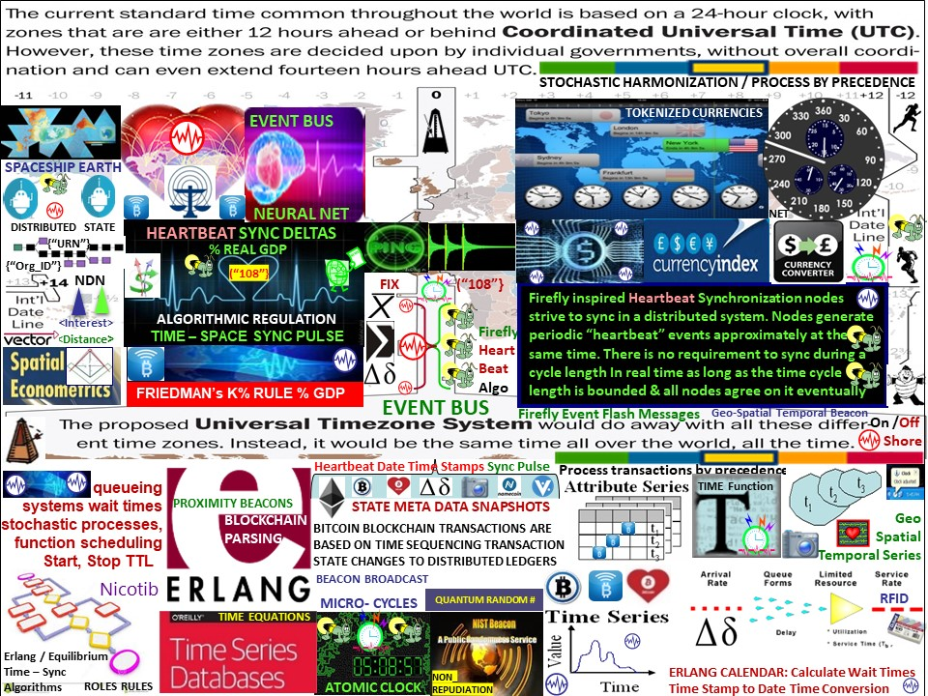
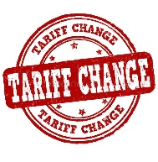

Slide 11

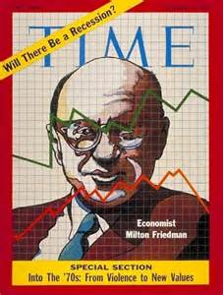

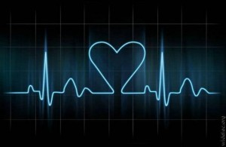
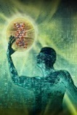

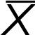
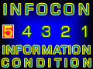

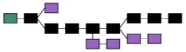

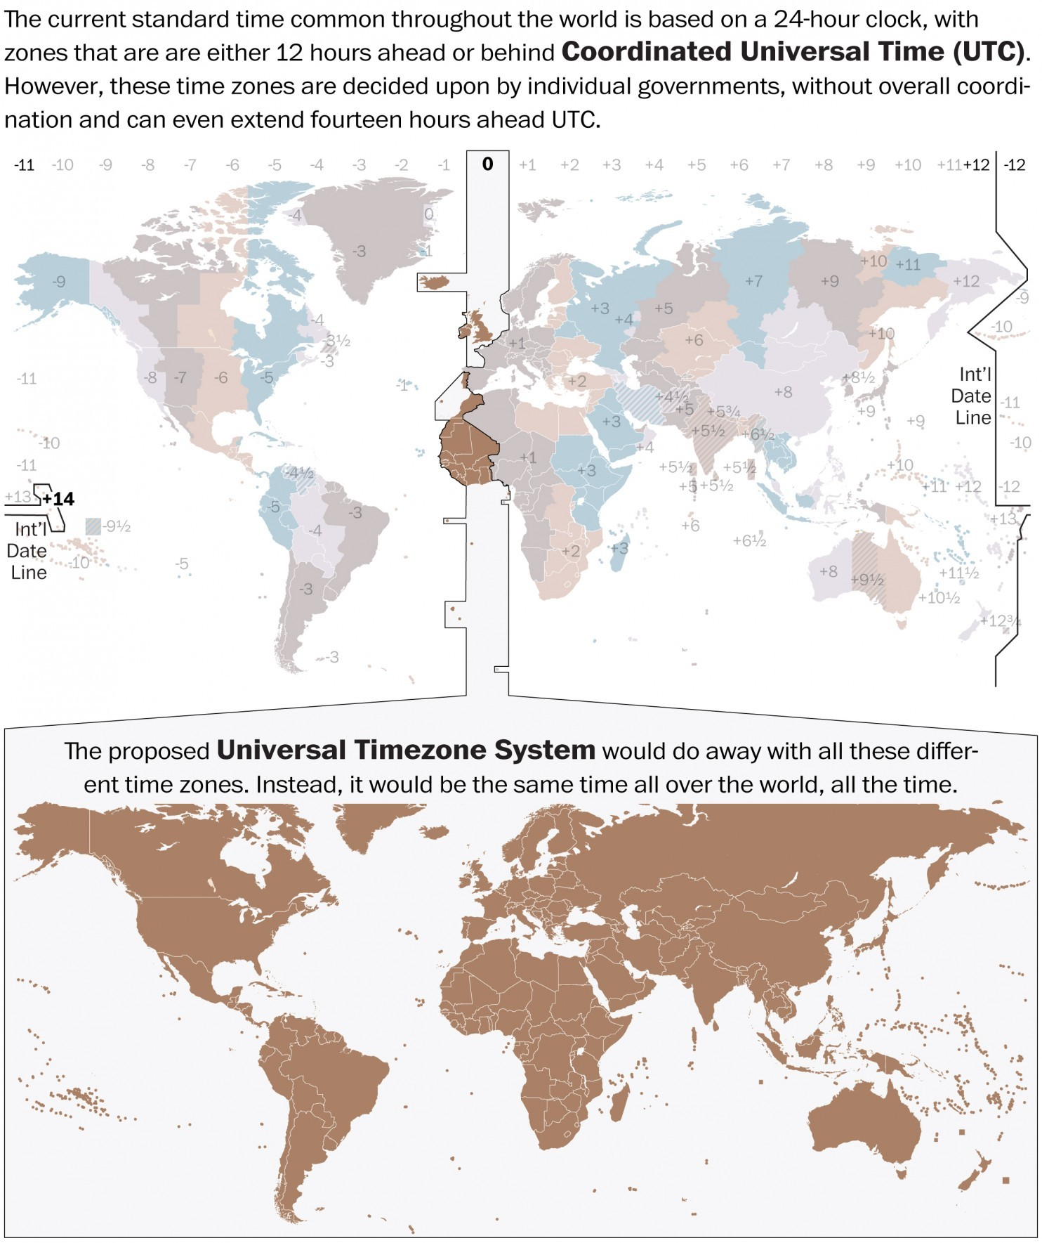
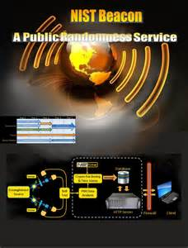



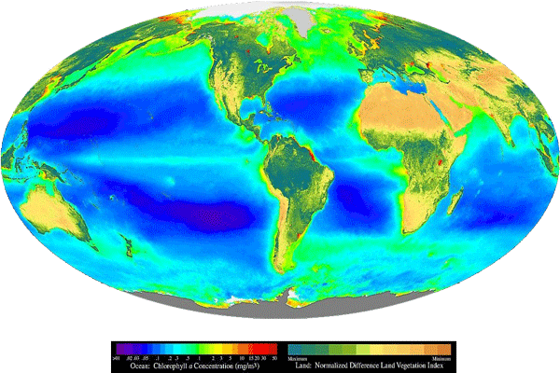


















BLOCKTIME ARBITRAGE
ALGORITHMIC REGULATION
Economic Heartbeat
TERRA
TRC
FIX {“108”}
WorldCoin
K%
FEDCOIN
STATISTICAL MEAN VALUE INDEX $$$
K% Real GDP Economic Pulse
ALGORITHMIC REGULATION
Macro Economic Econ $$$ Pulse
{“URN”}
K% RULE
{“Org_ID”}
UTZ TIME ZONE SYNC STOCHASTIC HARMONIZATION
FLASH HEARTBEAT MESSAGE BUS
RANDOM
#
Crypto Currency Micro-payments
Demurrage Logistic Parking Fees
FIX {“108”} HEARTBEAT MESSAGES
WORLD
ECONOMIC
HEARTBEAT
ECONOMETRICS
Non-
Repudiation
NON
Repudiation
Geo-Spatial Temporal Closer = < $$$ / FUEL
Tokenize Currencies
EVENT BUS
URN URN URN
SHORE
ON
OFF
Geo Spatial
Temporal Series
TIME
SERIES
DATA
{“ORG_ID”}
#1421
FIREFLY SYNC PULSE MATCHED
TO CLOSEST HEARTBEAT CYCLE
Land Use
FIREFLY
HEARTBEAT
ALGORITHM
cryptocurrency A to B to N… transactions = TAXABLE events
= universal event heartbeat flash message bus sync deltas
LEAD ECON
Geo-spatial
Temporal Econometrics
CPU CLOCK TIME / HEARTBEAT CYCLES
EPOCH
MICRO
CYCLES
EPOCH
STATE
META DATA
SNAPSHOTs
INTERNET OF MONEY formed by 1) Time Cycles 2) Syntax
NIST TIME BEACON
STOCHASTIC HARMONIZATION
BLOCKTIME ARBITRAGE
TIME STAMP SERVER
Notes:
Monetizing schemes = value sampling across Universal Time Zone UTZ system - stochastically harmonized value samples

Slide 12


The World Game’s (s) Great Redesign
TELEMETRY CONTROL GRID SYNC MATRIX
ADAPTIVE PROCEDURAL TEMPLATE
1919 BLACKSOX WORLD SERIES GAME FIXING RULING
Firefly Heartbeat Sync nodes strive to sync in a distributed system. Nodes emit periodic “heartbeat” events at approximately the same time. There is no need to sync during a cycle as long as the cycle length is bounded & nodes eventually agree. HBC’s method stipulates clock cycle values e.g., 5, 10, 15..
USPTO 13/573,002 / SCOTUS 573 U.S. 134 SCt 2347 “Alice in Wonderland Ruling”

Slide 13



TIME - SPACE
Banks, Tech firms’ form teams to assert foundation tech as a legal basis for IP intellectual property claims for programmable $$$ DeFI / TRADEFI
Use Case: Tokenize Europe 2025 initiative: reuse DoD / NATO's structured data brevity OPSCODES mapped to 2525A, B, C, D symbols needed for A.I. man-machine interface
Reuse, modify 300 + Use Case message set templates data element FFIRNs FFUDNS
Of system of systems engineering architecture structure data exchange (DoD) (NATO)
.
GENESIS

Slide 14















FIREFLY - Heartbeat Algo
Bologna Italy / Hungary / China Universities
ECO ECONOMIC HEARTBEAT
(“108”}
K%
ECONOMIC MACRO CYCLES
TIME-SPACE SYNC
K% GDP RWA RULE
FEDCOIN
WORLDCOIN
LENGTH OF REAL TIME CYCLE IS ARBITRARY AS LONG AS NODES EVENTUALLY AGREE
Luxor Temple Egypt:
"The shortest
path towards knowledge
of truth is nature"
TERRA
TRC
STAT MEAN VALUE INDEX
STATISTICAL MEAN INDEX
SCHELLING POINT TRUTH
TARIFF TOOL
ZONE CALC
METRICS, METERS
Temple of Man
NEURAL NET
EMULATION
BLOCKCHAIN PARSING Erlang
COMMODITY
PRICE INDEX
TIME EQUATIONS
{“Org_ID”}
{“URN”}
LEAD ECONOMIC INDICATORS
FRIEDMAN’s K% RULE
ALGORITHMIC REGULATION
ETF
TOKEN ECONOMICS
FIREFLY inspired Heartbeat Sync Algo
Crypto Currency
TIME STAMP
SERVER / SERVICE
PRECEDENCE
PROCESSING
UTZ SYNC
PULSE
SYNC
DELTAS
ETF
NON
REPUDIATION
{“URN”} {“URN”}
TARIFF TOOL
ZONE CALC
METRICS
DEMURRAGE
PARKING Logistic Fee
Incentives
UTZ TIME ZONE SYNC
MICRO
Transactions
{“DAO_ORG_ID”}
$$$
SYNC TO CLOSEST HEARTBEAT
HEARTBEAT EVENT FLASH MESSAGE BUS
EVENT
STATE SNAP
EVENT
STATE SNAP
SYNTAX
NONCE HASH
EVENT
STATE SNAP
{“URN”} {“URN”}{“URN”}
UTZ STOCHASTIC HARMONIZATION
FIX (“108”}
Universal
Metrics
/ Meters
Geo-spatial
Temporal
Syntax-Semantic
Sync & Consensus
Net, Net of $$$ formed by Time Epoch Cycles / Syntax
{“Org_ID”}
RFID
TARIFF TOOL
ZONE CALCULATION
$$$
“Heartbeat Synchronization nodes in a distributed system generate periodic local heartbeat events approximately at the same time. It differs from classical clock sync in that nodes are not interested in counting cycles and agreeing on the ID of the current clock cycle.
No rule governs the length of a cycle with respect to real time as
long as the length is bounded & all nodes agree on it eventually”
ON / OFF
SHORE
SYNC DELTA STATE META DATA SNAPSHOTS
Notes:
Firefly inspired stochastic harmonization combined with cycle Heart Beacon Cycle: Fireflies adjust the phase of their next heartbeat based on incoming ﬂash messages using an algorithm inspired by mathematical models of ﬁreﬂy synchronization. There is no requirement regarding the length of a cycle with respect to real time as long as a length is bounded and all nodes agree on it eventually. What we are interested in guaranteeing is that all nodes start and end their cycles at the same time, with an error that is at least one, but preferably more, orders of magnitude smaller than a chosen cycle length. Firefly heartbeat synchronization reduces uncertainty in stochastic networks" -- especially when firefly's near consensus (statistical mean) that is matched to nearest Heartbeat Beacon micro-cycle schedule news-casted over wide areas. Stochastic Harmonization of FOREX Networks. is a practical application of the concept described in image 8 where algorithms inspired by a species of fireflies who strive to achieve blinking pattern consensus during mating activities are used in concert with established heartbeat state meta data snapshot harvesting intervals. Firefly events matched with cyclical heartbeat cycles would require a read / write, store and forward service. Ceilometer as a Time-Series-as-a-Service Ceilometer API is a time series read/write service, useful in auditing leveraging a time-sample API as part of an event subsystem. = new project called Gnocchi, Gnocchi is split in two parts: a time series API and its driver, and a resource indexing API with its own driver. Having two distinct driver sets allows it to use different technologies to store each data type in the best storage engine possible. The canonical driver for time series handling is based on Pandas and Swift. The canonical resource indexer driver is based on SQLAlchemy. See https://julien.danjou.info/blog/2014/openstack-summit-juno-ceilometer
Firefly inspired Heartbeat Synchronization: in a paper entitled Fireﬂy-inspired Heartbeat Synchronization in Overlay Networks by the University of Bolonga and Trento Italy along with the University of Szeged, Hungary: “Heartbeat synchronization strives to have nodes in a distributed system generate periodic, local “heartbeat” events approximately at the same time. Many useful distributed protocols rely on the existence of such heartbeats for driving their cycle- based execution.. The heartbeat synchronization protocol for overlay networks is inspired by mathematical models of ﬂash synchronization in certain species of ﬁre ﬂies. Nodes send ﬂash messages to their neighbors when a local heartbeat triggers. Fireflies adjust the phase of their next heartbeat based on incoming ﬂash messages using an algorithm inspired by mathematical models of ﬁre-ﬂy synchronization. Heartbeat synchronization strives to have nodes in a distributed system generate periodic, local “heartbeat” events approximately at the same time. It differs from classical clock synchronization in that nodes are not interested in counting cycles and agreeing on a ID of a current cycle. There is no requirement regarding the length of a cycle with respect to real time as long as a length is bounded and all nodes agree on it eventually. The goal is to guarantee that all nodes start and end their cycles at the same time, with an error that is at least one, but preferably more, orders of magnitude smaller than a chosen cycle length.
Firefly heartbeat synchronization reduces uncertainty in stochastic networks". In context with the Internet of Everything Value index, cross network and system stochastic harmonization will help improve the process of searching for unused resources and unmet needs of goods at rest and in transit in context with geo-spatial temporal snapshots in time enabling the redirection, re-vectoring of assets in near real time to point of consumption, point of need resulting in a more efficient (re) distribution scheme, savings in fuel and support for real time news-casting / beacon broadcasting, news-casting, replicating advertisements to subscribers.
FIREFLY INSPIRED HEARTBEAT ALGORITHM University of Bologna / University of Hungary LINK: http://www.slideshare.net/StevenMcGee2/fireyinspired-heartbeat-synchronization

Slide 15














THE TERRA (TRC)
SHELLING POINT
ECONOMIC HEARTBEAT
FEDCOIN / WORLDCOIN
Trade Reference Currency
K %
{“URN”}
(“Org_ID”}
ALGORITHMIC
REGULATION
SLA: Closer = Cheaper
Closer = Less Fuel
= Less Time, CO2
{“TOKENs TAGS”}
WAVES
{“URN”}
</URN>
{“URN”}
{“URN”}
</URN>
{“URN”}
ETHEREUM
TOKENIZES CURRENCIES
TRADE
ZONES
Friedman’s K % Rule
TARIFF
ZONES
DEMURRAGE FEES
MICRO PAYMENTS
TARIFFS
TARIFFS
Terra Trade Reference Currency TRC "world currency" Bernard A. Lietaer Belgian economist proposed 1991 Basket of 9-12 most important commodities. Public issued demurrage fees for storage, shipping, handling
STOCHASTIC HARMONIZATION
UNIVERSAL TIME ZONE UTZ
Example: 100 Terra = 1 barrel oil
+ 10 bushels of wheat + 20 kg of copper + 1/10 Oz gold
UNIVERSAL MESSAGE EVENT BUS
(“Commodity_Tokens”
{“TARIFF TRADE ZONES”}
{“Org_ID”}
{“URN”}
FIREFLY – HEARTBEAT ALGO
MATCH FIREFLY EVENT SYNC TO CLOSEST CLOCK CYCLE
$$$
$$$
Proximity
Beacons
Closer is Cheaper Closer is Faster
Logistics Demurrage fees
EVENT BUS
Process Events By Precedence
Firefly inspired Heartbeat Synchronization nodes strive to sync in a distributed system. Nodes generate periodic “heartbeat” events approximately at the same time.
It differs from classical clock sync in that nodes are not interested in counting cycles to agree on the ID of the current clock cycle. There is no requirement to sync
during a cycle length In real time as long as the length
is bounded and all nodes agree on it eventually”
Geo
Spatial
Temporal Series
HEARTBEAT
FLASH MESSAGES
</URN> {“ORG_ID”}
EVENT BUS
French newspaper "Le Fédériste“
"L'Europa monnaie de la paix"
Money of peace" Born Jan 1st 1933
EDISON / FORD
MONITARY
OPTION 1921
$$$
“crops hold value best”

Slide 16









ECONOMIC HEARTBEAT
WAVES
TERRA
TRC
FIX {“108”}
K %
GDP
GDP ECONOMIC HEARTBEAT
GDP
K%
MACRO ECONOMIC VALUE STAT MEAN $
TOKENIZES
CURRENCIES
ECO
Econ
Pulse
TRADEFI / PRICE / SPEED MATCH
K% RULE ECONOMIC HEARTBEAT
K% VARIABLE YEARLY GDP SNAPSHOT
'K-Percent Rule Macro economic money-supply heartbeat automatically adjusts $ supply by a set amount “K" variable regardless of cyclical state of the economy e.g., set growth rate variable to real yearly % GDP
{“URN”}
(“URN”}
{“URN”}
(“URN”}
ALGORITHMIC REGULATION
{“Org_ID”}
{“Org_ID”}
BASKET OF GDP / CRYPTO / CURRENCY INDEX
UTZ TIME SYNC
{“Asset Class”}
{“Asset Type”}
TAFIFF TRADE ZONES
CALC TOOL METRICS METERS
TOKENS
HEARTBEAT MESSAGE EVENT BUS
FIREFLY EVENT FLASH MESSAGES
HEARTBEAT
STATE
SNAPSHOTS
SYNC to
CLOSEST HB CYCLE
TOKENS
TERRA TRC Demurrage Parking Fee
TARIFF Fees Metrics, Meters, Algorithms…
FIREFLY - HEARTBEAT SYNC ALGO
HASH
NONCE
HASH
NONCE
HASH
NONCE
BLOCK
“Heartbeat Synchronization strives to have nodes in a distributed system generate periodic local “heartbeat” events approximately at the same time. It differs from classical clock sync in that Nodes are not interested in counting cycles and agreeing on the ID of the current clock cycle. There is no requirement regarding the length of
a cycle with respect to real time as long as the length
is bounded and all nodes agree on it eventually”
CPU CLOCK EPOCHS / HEARTBEAT CYCLES
Notes:
Economist Milton Friedman predicted the rise of a computer capable of automatically adjusting the inflation rate of money, and this is precisely what we see in the case of bitcoin, as a regulatory algorithm intelligently adjusts the mining difficulty to make the issuance of blocks more or less easy depending on the demand for network hashing power. No money system we have seen to date can claim it is chronologically regulated. The universal construct of time is the backbone of the cryptocurrency digital economy. Investopedia K % Rule Source: https://investopedia.com/terms/k/k-percent-rule.asp
Satoshi Nakamoto’s Bitcoin key building block is a time stamp server. Satoshi Nakamoto: "Bitcoin is intended to be paired with the market place" "the blockchain stores references to market indexes" Globalization involves multi-national corporate entities vying for control of regional resources. It follows that a proven strategy to identify, track, and monitor resources regionally within the global economic matrix is needed. Bitcoin cryptocurrencies as programmable money and the internet's heartbeat, heartbeat messages timed to harvest data during micro economic cycles then aggregated into a composite economic heartbeat pulse as Economist Milton Friedman’s K% rule is a clear and present opportunity for trade equity and economic system of systems stability. Source: http://sawconcepts.com/index/id43.html

Slide 17

























13/573,002 HEART BEACON CYCLE
Time -Space meter, metrics / Universal data event, alert bus
Internet of Everything “ability to hear the world’s heartbeat”
VECTOR: quantity having direction and magnitude
position of a point in space relative to another point
TIME STAMP BY Org_ID, URN Before FUSION CENTER
SIOP
TIME STAMP 1
TIME STAMP 2
TIME STAMP 3
MACRO CYCLES
“THE GRAIL”
SLA
TIME
Metrics
SPACE
Meters
SYNC
COMMON
PICTURE
SEED
_CLOUD
{“108”}
{“108”}
{“108”}
FILTER BY ROLE <TYPE> <CLASS>
{“URN”}
QUANTUM
URN
URN URN URN
Uniform
Resource Name
NON-
REPUDIATION
FLASH Message
UNIVERSAL DATA EVENT BUS
Syntax Lexicon
PRECEDENCE PROCESSING
NIST CYBER BEACON RANDOM # BEACON
<Org_ID> {“URN”} {“URN”}
REST
ARREST-D
{“FILTERS”}
FIREFLY – HEARTBEAT ALGORITHM
Universal Event / Alert Bus
+ 2
Geo-spatial
{“108”}
Stochastic Harmonization UTZ SYNC
+ 1
Heartbeat synchronization strives to have nodes in a distributed system generate periodic, local “heartbeat” events approximately at the same time with a goal of all nodes starting and ending cycles at the same time eventually = map to closest
OPTEMPO HEARTBEAT
ASYNC
HASHGRAPH
Consensus Algorithm
Time Averaged
Time Stamping
+ 0
Distance Est
Service
IDMaps
SonarHops
+ 1
WATER DROP IN POND MEME
FOAM spatial protocol
Ethereum Blockchain
SYNC
Flash HB Messages
+ 2
PAUL REVERE MEME LINEAR SEQUENTIAL
World Computer
Neural Network
SYNC
SPACE – TIME Equations
BLOCKCHAIN PARSING
< / = / >
ASYNC
HEARTBEAT SYNCRONIZATION
State Meta Data
Heartbeat Snaps
{“URN”}
FIREFLY SYNC CONSENSUS
MICRO
CYCLES
{“Org_ID”}

Slide 18



















CIRCUIT BREAKER
FIX “108” Heartbeat Message
Q.R.N.B
{“EVENT”}
FIX
< = >
TTL
{“108”}
{“EVENT”}
{“THRESHOLD”}
SLA
SLO
ALGORITHMIC REGULATION
UTZ TIME ZONE STOCHASTIC HARMONIZATION
NON-
REPUDIATION
START
TTL
STOP
{“108”}
QUANTUM
WAVE EVENT
DETECTION
UTZ TIME ZONE SYNC
RaQL
Q VALUES
NASH
Equilibrium
Algorithms
SOUND WAVES enable
Different types of quantum tech to “talk”
{“108”}
Game
Theory
{“108”}
{“EVENT”}
Peg event reports to closest Heartbeat EPOCH Interval
{“108”}
SOUND WAVES QUANTUM
COMPUTER SPEED PARITY
Waves
Quantum
STOP
</108>
Send signal to
Master process ID #
= new config /
Worker process checks new
config
MESSAGE BUS
STOCHASTIC HARMONIZATION
TRANSACTION RATE, SPATIAL – TEMPORAL METRICS
MASTER
CONTROLLER
SERVER ON / OFF FLOOR ADJUST
“LENGTH OF REAL TIME CYCLE IS ARBITRARY AS LONG AS NODES EVENTUALLY AGREE
SYNC TO CLOSEST
WORKER/TASK
HEARTBEATS
IDMaps
SonarHops
SPACE-TIME Meters
Metrics
Distance
Estimation
Service
HEARTBEAT
Quantum Speed Limit
Erlang Time Equations
PRICE DISCOVERY
ALGORITHMS
SHADOW BANKS
FIREFLY HEARTBEAT ALGO
{“TAGGED_CRYPTO”}
On Shore
Off Shore
Hop by Hop
INTEREST
DISTANCE
{“ORG_ID”} {“URN”}
{“EVENT”}
{“EVENT”}
Zero Trust Transaction
STATE
META
DATA SNAPS
on TIME X, in Y condition at PLACE Z
Capital Market Smart Contracts
{“ORG_ID”} {“URN”}
Notes:
STAAS: Space Time As A Service. A use case of the firefly inspired heartbeat synchronization algorithm in stock and currency exchanges is algorithmic regulation cited by economist Milton Friedman. For example, improving temporal trade parity between Bitcoin Blockchain & conventional stock exchanges by using the firefly-heartbeat algorithm to take trade speed samples among trade populations across time zones to determine an optimal trade speed / frequency as a statistical mean. Trading velocity far exceeds Bitcoin's current transaction rates estimated to be between 3 - 7 transactions per second and far exceed non-HFT trading capacity. A method is needed to establish temporal trade parity and account for on floor / off floor trading disparity -- enter STAAS Space - Time As A Service using a novel stochastic harmonization algorithm based on the mating behavior of certain species of fireflies that strive to sync during mating activity matched to the closest Operational Tempo OPTEMPO heartbeat cycle.
Wall Street Stock Exchanges must solve the problem where High Frequency Trade transactions far exceed the ability of a regulatory, monitoring 3rd party's (DCCC) ability to record, verify and validate transactions -- a computational job that the Bitcoin Blockchain is being used to solve. Project Medici intends to create a blockchain based securities exchange. “Medici,” the project aims to democratize Wall Street in much the same way bitcoin seeks to democratize currency and payments. By operating separate from traditional stock exchanges and the big corporate banks, it could eliminate certain loopholes in the system and reduce the costs associated with issuing and juggling stock.
All sophisticated algorithms, bots, mots, scripts, agents.. make use of the heartbeat -- opportunities, intervals, windows in time. High frequency flash trade algorithms are sophisticated and distributed -- however, all algorithms report to a single master controller. The heartbeat = start bit / stop bit, Time To Live = algorithm on / algorithm off / algorithm duration. Heartbeat </108> messages and the heartbeat time cycle can be used to limit trade sessions by trading session or trade time cycle e.g., one trade per cycle and / or n trades per session. Geo-spatial temporal techiques like IDMaps and SonarHop and the firefly heartbeat stochastic harmonization method can be used to account for trades distributed across time zones and trading on the stock exchange floor and off where the length of the fiber optic cable makes a difference in High Frequency Trade volume. Time cycles match Bitcoin blockchain transaction rates currently estimated to be 3 – 7 per second with High Frequency Flash trade rates. Project Lighning's sync delta approach -- sending only the changes to ledgers from one (heartbeat) time cycle to the next instead of refreshing the entire ledger is one solution to address trade parity.

Slide 19














Energy Attenuates over Distances
ENERGEUM TOKENS
{“URN”}
CLOSER=
CHEAPER
{“ORG_ID”}
BLOCKCHAIN MICROGRIDS
USPTO 13/573,002
BLOCKCHAIN MICROGRIDS
TOKENIZED ECONOMY
IEEE C37.118 Time Synchronization
Harmonization Heartbeat update Interval
Geo Spatial
Temporal Series
Paul Revere = Linear, Sequential meme
Water Drop Meme
Geospatial Radius
PMU data time-stamp measure C37.118
Phase 2: Shared file stores data for 5 tags:
(1) Active ID
(2) Heartbeat 1.
(3) Heartbeat 2.
(4) Device Status 1.
(5) Device Status 2.
BLOCK TIME – SPACE ARBITRAGE TRADE
ENERGY TOKENS FOR FOOD, WATER,
TRANSPORTATION LOCALLY, REGIONALLY
WATER DROP
MEME= RADIUS DISTANCE FROM
ENERGY SOURCE
CLOSER
= < CO2
SLA/O
CLOSER
= < Fuel
Micro Payments
Demurrage Fees
BLOCH
SPHERE
Hopf
TAG | ExDesc | digitalset | UniInt does not examine the remaining attributes, the point source and location must match
ActiveID | [UFO2_ACTIVEID]
IF1_Heartbeat (IF-Node1) | [UFO2_HEARTBEAT:#]
IF2_Heartbeat (IF-Node2) | [UFO2_HEARTBEAT:#]
IF1_DeviceStatus (IF-Node1) | [UFO2_DEVICESTAT:#]
IF2_DeviceStatus (IF-Node2) | [UFO2_DEVICESTAT:#]
IF1_State (IF-Node1) | [UFO2_STATE:#] | IF_State
IF2_State (IF-Node2) | [UFO2_STATE:#] | IF_State
IEC 61850 Objects logical nodes, data
objects or data attributes resends
message with the heartbeat cycle
ENERGY TOKENS
/ COMMODITIES
WATER
{“Org_ID”}
</EVENT>
SYNC
DELTA
HEART
BEAT
</EVENT>
DROP
MEME
IEEE 802.1AG HOP BY HOP DETECTION
IEEE 802.11 HbH HOP BY HOP CONTROL
Match events to
Closest HBC
</EVENT>
< HOPS = CHEAPER Sync Delta Heartbeat Messages
{“UUID”}
CROSS LEVEL OVERAGES / SHORTAGES ADJUST FOR
TIME / DISTANCE BETWEEN NETWORK NODES
</EVENT>
FIREFLY EVENT BUS
Distance Estimation Service
SonarHops
{“UUID”}
IDMaps
</EVENT>
Micro Payments
Demurrage Fees
Micro
Payments
Heartbeat
State meta
Data snapshots
FIREFLY-HEARTBEAT ALGO EVENT MESSAGE BUS
</INTEREST>
.0001 .05 .01 .1 0 5 15 30 99
NDN
NDN
{“DISTANCE”}

Slide 20


Slide 21




United States US 20120092107A1 (12)
Baptista De Alves Martins (43)
Pub. Date: Apr. 19, 2012
PROPULSION SYSTEM USING THE ANTIGRAVITY FORCE OF THE VACUUM
ENERGY PRODUCTION
Fig 10 e
ABSTRACT: A propulsion system for aerial, terrestrial, underwater or space propulsion, through manipulation (or engineering) of the vacuum with proper electromagnetic interactions. Vacuum manipulation.. new form of propulsion, and has applications in ENERGY production and on CHANGE of TIME decay of radioactive elements. Opposing magnetic or electric fields create a mass repelling force, while attracting magnetic or electric fields create a mass attracting force. This vacuum manipulation process.. used to propel a mass that contains field sources that perturb the vacuum. .. the creation of a repulsion point in space through the interference of
two or more longitudinal ELECTRO dynamic (micro) waves
WATER
Fig
10 d
DROP
MEME
CLOSER=
CHEAPER

Slide 22



Energy Attenuates over Distances
“When space-time spins, it creates mass. It produces energy in space that radiates. This radiation is what we call mass”. Nassim Haramein
ENERGEUM TOKENS
CLOSER=
CHEAPER
TOKENIZED ECONOMY
SLA Service Level Agreements
SLA
Closer =
Cheaper
Nassim Haramein’s work is geometrically based, at the fundamental level spacetime = honeycomb of overlapping spheres of energy each having a singularity at its center.
Harmonic Sphere Flux Resonator
ENERGY / DATA
Yttrium iron garnet spheres serve as magnetically tunable filters and resonators for microwave frequencies. YIG filters are used for their high Q factors, typically between 100 and 200.
Sphere made from a single crystal of synthetic yttrium iron garnet acts as a resonator. Wikipedia
https://www.researchgate.net/
YIG sphere placed in
maximum magnetic
field of a microwave
cavity mode.
Fig 1 - Li Zheng
YIG sphere and the uniform external bias magnetic field.
YIG/graphene structures and the electrodes used to measure the dc voltage due to the IREE charge current in the graphene layer resulting from the spin currents generated by microwave FMR spin pumping.
Bloch Sphere
Water Drop Meme
Time
Series
Data
IEEE 802.1AG HOP BY HOP DETECTION
IEEE 802.11 HbH HOP BY HOP CONTROL
The creation of spinlogic devices, which allow the control and transport of the spin current over long distances, is one of the major research challenges in spintronics. In this regard, graphene-a single atomic layer of carbon atoms in a honeycomb lattice [see Fig.
1(c)]-has attracted great attention as a promising material for spin-based devices due to its exceptional electronic transport
properties, excellent charge carrier mobility, quantum transport, long spin diffusion lengths, and spin relaxation times [42]

Slide 23









(RADIO) WAVE FORMS BEGAT DIGITAL DATA
USPTO 13/573,002
573 U.S. 134 SCt 2347
“Alice in Wonderland Ruling”
</Org_ID>
TIME CHAIN
OPSCODE Brevity
Codes / Symbols
{“URN, URN, URN”}
AI
EPOCH
EPOCH
EPOCH
Sync
Delta
A.I.
NET OF MONEY formed by 1) Time Cycles 2) Syntax
Closer is Cheaper Closer is Faster
WATER DROP PHYSICAL NATURAL
MEME
USPTOb13/573,002
SYSTEM OF SYSTEMS
STRUCTURED DATA
“HeartBeat”
EPOCH
TIME INTERVALS

Slide 24


Fisher information flux flows are generated and stored in wave packets as they propagate. This temporal aspect is crucial for understanding how information builds up in a system over time
USPTO 13/573,002 Time – Space Meter
Metrics
Continuity equation for flow of Fisher information in wave scattering: Nature / ISF
International Space Federation
An electromagnetic wave scattered at an object carries locally defined and conserved information about all of the object’s constitutive parameters. Specifically, we introduce the density and flux of Fisher information for general types of wave fields and identify the corresponding sources and sinks of information through a fundamental continuity equation. our theoretical predictions involve a movable object embedded in a disordered environment by measuring the corresponding Fisher information flux at microwave frequencies. Our results improve the understanding of the generation, propagation of information supports tracking and designing the flow of information in complex system of systems environments.
EPOCH
EPOCH
EPOCH
Sync
Deltas
FOUNDATION FOR NET, NET OF $$$, WEB 3

Slide 25







THESIS: All things net, net of programmable $$$ are formed
using:
Time epochs created by
quartz crystal silicon chips
2) Syntax used / not used
as programming instructions
during epoch time cycles
ENERGY / DATA WAVE METRICS / METERS
BELL STATE QUANTUM COMPUTING
Hopf
Fibration
GENESIS BLOCKCHAIN BLOCK
STANDING ELECTRO- MAGNETIC WAVE
WATER
DROP
Genesis
Epoch
USPTO
13/573,002
POND MEME
GENESIS TIME EPOCH
EPOCH TIME INTERVAL CYCLES
Quantum Computing Vibrations encode, process data like quantum computers. A simple mechanical system built from aluminum rods uses vibrations to encode information, mimicking quantum computing in a non-quantum system. "Light is made from photons, the quantum of light. mechanical vibrations or sound waves can be described in a quantum-mechanical manner i.e., composed of phonons: the smallest possible units of mechanical vibration“
Link: https://phys.org/news/2018-06-quantum_1.html
“Nature may reach the same result in many ways. Like a wave in the physical world, in the infinite ocean of the medium which pervades all.. Nikola Tesla

Slide 26

Water drop in pond meme
https://www.spaceandmotion.com/
Physical Reality: 1. One Substance. Space exists with properties of an elastic solid wave medium, propagating longitudinal waves in all directions, thus forming standing waves in all directions. When these standing waves are in-phase (coherent) around a central point then a spherical standing wave naturally forms - space vibrates in and out around the central point, which we call the particle. There are two opposite phase spherical standing waves, which create the electron and positron (matter and antimatter),
2. One Law. The velocity of the waves is proportional to the wave amplitude (bigger waves travel faster). Where these waves are coherent, forming spherical standing wave 'particles', the wave amplitude is higher, and the waves travel faster. This, as i shall explain, is the foundation of all matter interactions, the source of causal connection and absolute truth.
On Truth & Reality
The Wave Structure of
Matter (WSM) in Space
Paul Revere Linear, sequential meme
And as I shall explain in Einstein's relativity, when we apply this one law, where the wave velocity changes the wavelength also has a corresponding change such that we can never observe this change. This relates to the Lorentz transformations, the negative solution of the Michelson Morley experiment, and why we always measure a constant velocity of light even when it changes, thus why we cannot measure our motion through absolute space.
With respect to time, physics was always telling us that time is caused by frequency (and fundamentally by motion as the wave motion of space), since time equals the inverse of frequency t=1/f.
From our wave equation we see that while the velocity and wavelength change, the frequency remains constant, giving rise to an absolute time in the universe. This was one central problem of Einstein's relativity, he changed time and maintained a constant velocity of light, when the opposite is true. (Yes, this one property of waves from this simple wave equation has caused us so much confusion!).
Why matter and energy are equivalent, since a wave is a flow of energy between two states of the wave medium Space - kinetic energy (vibratory motion of space) and potential energy (elastic deformation of a nearly rigid space). Why matter and antimatter annihilate, due to destructive wave interference. How matter and antimatter can be created from apparently 'empty' space. How science can exist, since the spherical in and out waves provide continuous two way communication between matter in space (empirical knowledge), and the waves behave in a necessary manner due to this one law (logical knowledge).
Wave velocity is the velocity of light, ~ 3 * 10^8 m/s, the wavelength is the Compton wavelength ~ 10^-12 m, and the frequency ~ 10^20 Hz. So in a pin head there are roughly a billion billion billion standing waves, each vibrating a billion trillion times a second. i.e. These standing waves are very small, and vibrate very fast, thus explaining how such complex standing wave structures (like us) can evolve in space. The fundamental equation of the universe is the simple wave equation; Velocity (C) = Frequency (f) * Wavelength (y)
Combined with the equation of the sphere (which is also Pythagoras' Theorem and the metric equation of Special Relativity), and explains the geometric foundations of reality, why space is three dimensional. x^2 + y^2 + z^2 = r^2
“What we observe as material bodies and forces are nothing
But Shapes and variations in the structure of space” Schrodinger
“Simplicity is the ultimate sophistication”.
(Leonardo da Vinci)

Slide 27



ACOUSTIC PHONON
USPTO 13/573,002
in-phase motion of neighboring ions in a lattice vibration
EPOCH
EPOCH
EPOCH
“nodes eventually agree” stochastic harmonization temporal sync
Phonons: A phonon is a quantum of the lattice vibration, the collective motion of atoms constituting a crystal. There are two types of phonons: optical and acoustic. The optical phonon has high-frequency oscillation in the THz range and the unit cell
center of mass does not move. It undergoes a dipole interaction with light. The acoustic phonon propagates at sound velocity,
which is the first derivative of the phonon dispersion curve at
the Γ-point (wave vector k ≈ 0) in the first Brillouin zone. A
simple example is a one-dimensional diatomic chain, in which
the unit cell contains two atoms. In a crystal of N unit cells,
there are 2N atoms and 2N degrees of freedom of motion. The displacement of an atom from its equilibrium position is
expressed using plane waves with reduced wave vectors, defined within the first Brillouin zone. The oscillations are approximated
by 2N harmonic oscillators of different wave vectors.
The vibrational frequency is related to the wave vector through
the phonon dispersion relation. Phonons are created and annihilated in the harmonic oscillators. SOURCE: SCIENCE DIRECT: https://sciencedirect.com/topics/engineering/acoustic-phonon
THESIS: All things net, net of programmable $$$ are formed using: 1. Time epochs created by quartz crystal silicon chips 2) Syntax used / not used as programming instructions during epoch - temporal time cycles
SOUND WAVES enable Different types of quantum tech to “talk”
</EVENT>
SYNC
DELTA

Slide 29









QUANTUM LATTICE
USPTO 13/573,002
sawconcepts.com/index
Heart Beacon Cycle Time – Space Meter
Geo-Spatial Temporal Intensity Metrics
NDN
IDMaps
TRIANGULATION
SonarHops
{“Distance”}
{“Interest”}
Quadrature amplitude modulation
IDMaps assists Network Time Protocol (NTP) servers establish long term peering relationships
QAM by setting a suitable constellation size, limited only by the noise level and linearity of the communications channel
“Similarly, the electromagnetic force will also be found to vary continuously and retain a TIME-AVERAGED value”
FIREFLY – INSPIRED HEARTBEAT SSYNCHRONIZATION ALGORITHM
“LENGTH OF REAL TIME CYCLE IS ARBITRARY AS LONG AS NODES EVENTUALLY AGREE”
Sine wave of our blinking universe. The 4 fundamental forces will all be found to vary continuously when sampled at 2x the blinking frequency, per Nyquist-Shannon theory

Slide 30







Building Blocks:
Programmable
Economy / $$$
WORLD ECONOMIC Heartbeat
ALL THINGS NET FORMED WITH:
EPOCH TIME CYCLES
SYNTAX / Opscode Brevity codes
NIST Quantum Random Number Beacon
ALGORITHMIC REGULATION
HEARTBEAT SYNC DELTAS
MICRO MACRO
PROOF of SPACE-TIME
Epoch N
Epoch N +1
Firefly - Heartbeat Sync Algorithm
Heartbeat Event Message Bus
UTZ stochastic harmonization
Quantum Random # Beacon
Epoch Time Cycles
“The external environment could update resources at random…
One solution is a heartbeat: defining a default lease duration delaying updates until the next cycle”
E0 E1 E2 E3…
Genesis
Epoch
E2
SPACE
E0
E1
E…n
QUANTUM
RANDOM # BEACON
TIME
QubitCoin Interval: Every 30 Seconds
NIST TIME BEACON
Metrics / Meters
Structured Data Exchange
ROSETTA
STONE
BREVITY
CODES
{“Org_ID”}{“URN”}
Proximity Beacons
BLOCKTIME ARBITRAGE
300 +
Message
Sets
Work
flow
Filters
Geo
Spatial
SYNTAX LEXICON

